Slide 1
DISEASE CONTROL AND ENVIRONMENTAL HEALTH Environmental Health and Health of Communities/Individuals DCM 2

Slide 2
Quiz
1. As DCM 2 student attached to medical ward, you have just gotten a needle stick injury while doing a venipuncture on a newly diagnosed HIV positive client, all the following are your next step of action except.
A. Do not squeeze or rub the injury site
B. Wash the site immediately with soap and water.
C. Don’t use strong, irritating antiseptics (like bleach or iodine)
D. Don’t notify your supervisor after all you were wearing gloves.

Slide 3
Quiz
2. The infection prevention measures involves standard and additional precautions
True
False

Slide 4
Quiz
3. The following don’t constitute environmental health except.
Sanitation
Solid waste management
Vectors and Vermin
Occupational Health
All the above
None of the above

Slide 5
Quiz
4. All the following are water borne diseases except
Toxoplasmosis
Cholera
Hepatitis (A and E)
Food poisoning
Non-of the above

Slide 6
Quiz
5. The epidemiologic triad of disease transmission consists of all the following except
Agent
Host
Environment
Vector

Slide 7
Learning objectives
Define some common terms related to Environmental health
Give the background of Environmental health
List what constitutes Environmental Health
Explain the relationship between the environment, human health and disease.
State human activities that adversely affects the environment

Slide 8
Definition II
Health
A state of complete physical, mental, and social well-being and not merely the absence of disease or infirmity (WHO, 1948).
Control:
To regulate, restrain, correct, restore to normal. Ongoing operations or programmes aimed at reducing incidence and/or prevalence, or eliminating such conditions (John M.Last, 2001)

Slide 9
Definition I
Environment”
All that which is external to the individual host.
Can be divided into physical, biological, social, and cultural factors, any or all of which can influence health status in populations (Last, J. M., 1995).

Slide 10
Definitions III
Public health
Is "the science and art of preventing disease, prolonging life and promoting health through the organized efforts and informed choices of society, organizations, public and private, communities and individuals"

Slide 11
Definitions IV
5. WHO definition of Environmental Health
Comprises of those aspects of human health, including quality of life, that are determined by physical, biological, social, and psychosocial factors in the environment.
Refers to the theory and practice of assessing, correcting, controlling, and preventing those factors in the environment that can potentially affect adversely the health of present and future generations.

Slide 12
Background of EH
Environmental health as defined by the WHO includes:
Both the direct pathological effects of chemicals,
Radiation and some biological agents,
Effects (often indirect) on health and wellbeing of the broad physical, psychological, social and aesthetic environment (housing, urban development, land use and transport)

Slide 13
Things that constitute Environmental Health
Sanitation
Hygiene education
Excreta disposal
Food hygiene
Water supply
Solid Waste management
Liquid waste management
Vectors and vermins
Toxic chemical exposure
Air pollution
Principles of communicable diseases
Non-communicable diseases (NCDs)
Occupational health

Slide 14
Aspects of Environmental Health
Environmental epidemiology
Associations between exposure to environmental agents and subsequent development of disease
Environmental toxicology
Causal mechanisms between exposure and subsequent development of disease

Slide 15
Cont.
Environmental engineering
Factors that govern and reduce exposure
Preventive medicine
Factors that govern and reduce disease
Law
Development of appropriate legislation to protect public health

Slide 16
Basic requirements of a healthy environment
Clean air
Safe and sufficient water
Safe and adequate food
Safe and peaceful settlements
Stable global environment

Slide 17
The precepts of Environment
The physical environment, our habitat, is the most important determinant of human health
Protection of the environment and preservation of ecosystems are the most fundamental steps in preventing human illness
Environmental problems are global and long-term
Human belief systems are part of the problem

Slide 18
Contributors to the Environment
Chemical
Air pollutants, toxic wastes, pesticides,
Biologic
Disease organisms present in food and water
Physical
Noise, ionizing and non-ionizing radiation
Socio-economic
Access to safe and sufficient health care
Notes:
Volatile organic compounds (VOCs) are chemicals that contain carbon and are found in all living things. VOCs easily become vapors or gases. Along with carbon, they contain elements such as hydrogen, oxygen, fluorine, chlorine, bromine, sulfur or nitrogen

Slide 19
Environmental influences on people I
Physical environment is made up of air, water, soil, climate and other physical conditions
Biological environment eg people, vegetation, insects, infective organisms like amoebae, parasites, and bacterial etc
Cultural and social environment are customs, beliefs and organizations in society like family and kinships, religions, leadership and power structure.

Slide 20
Environmental influences on people II
Economic and political environment is made up of work, money and government e.g
Local community organization and self-reliance
Rural and urban economies
Political organization
Development policies.

Slide 21
Human dependence on the Environment
PH recognizes the environment as a primary determinant of health
Human species depend on media like air, water, soil and food.
Life is dependant upon the purity of air and oxygen exchange with green leafy trees and on the temperature of the air e.g any change in the temperature affects water temperatures, sea levels and plant life.

Slide 22
Water
Water is necessary for all life forms.
Human body is made up of 75% water
Only 25% of water on this planet is fresh water, not salty water. Fresh water is found in the ice of the polar ice caps.
Ground water makes up most of water remains leaving only 0.01% in lakes, streams, rivers and rainfalls
Life is dependant on fresh water sources and water’s drinkable quality to survive.

Slide 23
Soil
The quality of the soil in which plants grow is essential to the safety of the food chain
The quality of the soil is affected by its water supply and the deposition of the contaminants from the air.

Slide 24

Hazards
Bacteria, & viruses
Harmful chemicals
Tobacco smoke
Stress
Loud noises
A hazard is anything in the environment that can hurt you or make you sick.
Notes:
Procedure: Ask students to call out things around us that have the potential to hurt us or make us sick, then CLICK ONCE to make the boxed words appear. This is a good time to discuss what things we have control over, and what things we do not - i.e. smoking is a personal choice, but being exposed to air pollution is not.
Relevant Text from Student Reading:
“Every day, you come in contact with things in your environment that can help you or hurt you. Some of these things are important for keeping you healthy, such as oxygen or medicines. However, some of these things may be harmful to your health, such as tobacco smoke or snake venom. Things in the environment that are harmful are called hazards and include things like chemicals, disease-causing bacteria, loud noises and even stress. Hazards can be natural or human-made.”

Slide 25
Human actions that affect ecological equilibrium
Deforestation- responsible for RTIs
Industrial discharges into the air. This affects the quality of the air in that discharges from automobile exhausts pollute ozone layer.
Agricultural activities for example use of herbicides and pesticides result into coliform contamination and nutrient overload.
Climate change through Stratospheric ozone depletion
Desertification
Land degradation
Loss of biodiversity

Slide 26
Factors that can lead to a person being harmed by something in the environment
Existence of the source of harm
Environmental media eg air, water or soil
Receptor population (within exposure pathway)
Route of exposure eg inhalation, ingestion and dermal absorption
Infective dose

Slide 27
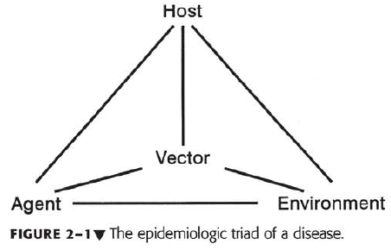
Relationship between environment, human health and disease I

Slide 28
Relationship between environment, human health and disease II
Environmental Health Science: Is the study of those factors in the environment that affect human health
Factors (“pollutants "or “toxicants”) in air, water, soil, or food
Transferred to humans by inhalation, ingestion, or absorption
Leads to adverse health effects
Notes:
NIEHS- National Institute of Environmental Health Science

Slide 29
Examples of disease manifestation
Lung disease
Reproductive effects
Teratogenic effects
Neurologic effects
Immunosuppression and hypersensitivity
Cancer

Slide 30
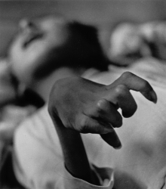
Minamata disease
The crippled hand of a Minamata disease victim
Is a neurological syndrome caused by severe mercury poisoning.
Symptoms include ataxia numbness in the hands and feet, general muscle weakness, narrowing of the field of vision and damage to hearing and speech.
In extreme cases, insanity, paralysis, coma, and death, later can affect foetuses in the womb
Notes:
Chiso minamata,

Slide 31
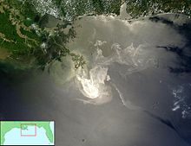
Deepwater horizon oil spill
Also referred to as the BP oil spill, is an oil spill in the Gulf of Mexico which flowed unabated for three months in 2010, and continues to seep.
It is the largest accidental marine oil spill in the history of the petroleum industry.
The explosion killed 11 men working on the platform and injured 17 others. On 15 July 2010

Slide 32
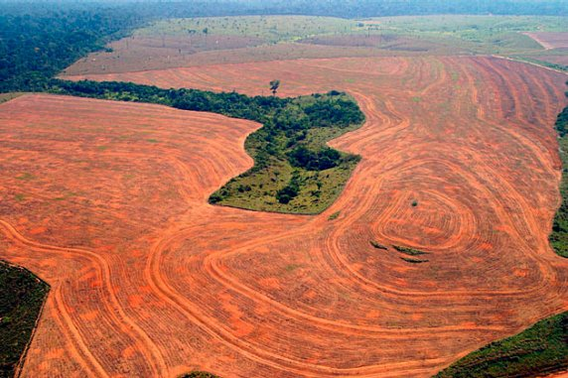
Rainforest destruction
Deforestation in Brazil’s Amazon rain forest has increased dramatically over the past decade as ranchers, farmers and loggers destroyed up to 10,088 square miles—roughly the size of New Hampshire—each year.
More than 50% of wildlife and 40% of the world’s oxygen comes from rainforests.

Slide 33
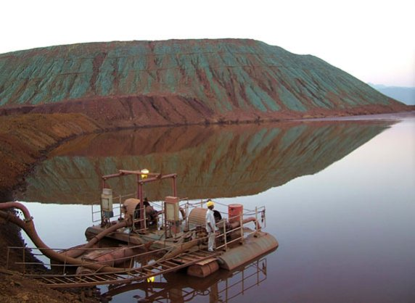
Industrial mining
Mining for precious metals is an economic driver in both developed and developing countries, but the environmental effects can be costly.
When holes are dug and components extracted, the resulting landscape is affected by soil erosion, and can experience the collapse of ecosystems knocked off balance.
Mined areas are rarely restored. Sukinda Valley in India contains more than 95% of the India’s chromite ore deposits.
The constant mining efforts have left it as one of the most polluted places in the world.

Slide 34
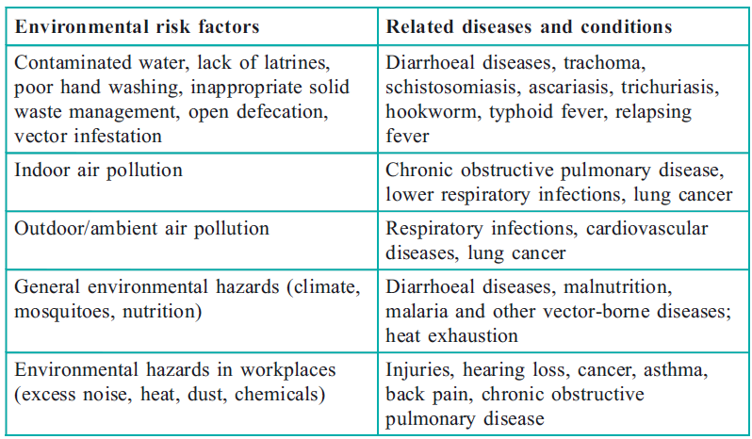
Major environmental risk factors with related diseases and conditions

Slide 35
Environmental agents implicated in adverse Reproductive outcomes
Exposure | Known/Suspected effect
Anesthetic compounds | Infertility, spontaneous abortions, fetal malformations and low birth weight.
Dibromochloropropane | Sperm abnormalities, infertility
Ioninizing radiation | Infertility, chromosomal abnormalities, childhood malignancies
Lead | Infertility, spontaneous abortions, developmental disabilities
Manganese | Infertility
Organic mercury | Developmental disabilities, neurologic abnormalities
Organic solvents | Cogenital malformations, childhood malignancies

Slide 36
Environmental Principles I
Everything is connected to everything else;
In water cycle of evaporation and condensation, burning fossil fuels, domestic and hospital wastes can result in air transport of mercury.
This will then be deposited in minute quantity into water bodies.
The organic mercury will be converted into methyl mercury which can be taken up by plants, these plants are then eaten by fish.

Slide 37
Environmental Principles II
Fish, unlike humans retain mercury and through bio-accumulation the mercury goes to the food-chain and later on consumed by man.
Mecury hinders the formation and development of the CNS of fetuses, infants and children as well as adults.
Another e.g. is lead in paint burnt in 1978

Slide 38
Principle 2: Everything has to go somewhere (Deposition)
Science of, “Matter cannot be created or destroyed” only disposed off through:-
Incineration
Water discharge
Burial in soil (land filling)
Aim:- provide opportunity to alter the waste product to a less toxic form (biodegradation), or Store product in a bio-unavailable form/place

Slide 39
Principle 3: The solution of pollution is Dilution
Example: Environmental and sanitation measures like dumping of waste (garbage) at river banks posses many health risks.
It is not a good practice but its what is in use in some cases.

Slide 40
Principle 4: Today’s solution may be Tomorrow’s problem
Environmental Scientists and Regulators are dealing with incomplete information and insufficient data for instance disposing of refuse/garbage in unlined landfill is discovered to be a source of ground water contamination.
Also, gasoline tanks that were buried to avoid an ugly landscape were found to leak over time.

Slide 41
Roles of medics in EH
Community involvement/public participation
Individual/population Risk Assessment
Risk communication.
Interpret and apply principles to practice.

Slide 42
Relationship between Environmental Health and the Health of the Community I
The environment determines how people live and which diseases they suffer from. People are affected by their environment and can change it for good or bad.
Example overgrazing or charcoal burning (biological) results into soil erosion and the creation of a desert (physical).
This in turn affects the life of the community.

Slide 43
Relationship between Environmental Health and the Health of the Community II
Illustrations about behaviour, environment and health;
Malnutrition is common among children in many parts of Africa due to an inadequate diet and customs tied to it e.g. eggs being a source of protein being eaten by adults (men)
There is no need to tell when to prepare baby food using paraffin if they cant afford. E.g. of effect of economic environment
Its useless telling school children to plant beans (source of plant protein) if the soil condition (physical environment) is unsuitable for its growth.

Slide 44
Summary
EHS is the study of those factors in the environment that affect human health
These factors represent chemical, biological, or physical agents contained in air, water, soil, or food, and are transported to humans via inhalation, ingestion, or skin absorption
Adverse health effects may be acute or delayed in onset, clinical or subclinical, and reversible or irreversible

Slide 45
References
Stanhope Lancaster, 5th edition Community and Public Health Nursing
C. H. Wood et al, 1997 Community Health, 2nd edition
John M. Last, 2001 A dictionary of Epidemiological

